Slide 1
ELECTRONIC SHOP MANAGEMENT SYSTEM
-DONE BY
CDT V.VIJAY
6471

Slide 2
INTRODUCTION
Electronic shop Management System is a very useful software used for various purposes of the electronic shopkeepers.
It can be modified according to the needs of the owner .
It serves the widespread scopes in making the work maintaining the record easier.
Its is not only useful for owner , but it is also useful for the customer un the way of handling it.

Slide 3
HOW IT WORK
It works on the basic principle of the linking python and a database .
At first , the command will be given in python software afterwards the command will be sent to the database.
There in the database the command will fetch the demanded data and it will it to the python software.
Then the required output will be shown the python software.

Slide 4
Source code
import mysql.connector as sql
import datetime
conn=sql.connect(host='localhost',user='root',passwd='manager',database='electronics')
#if conn.is_connected():
# print("Successfully Connected")
c1=conn.cursor()
t_date=datetime.date.today()
t_time=datetime.datetime.now()
print("DATE:",t_date.day,"/",t_date.month,"/",t_date.year,"TIME:",t_time.hour ,":",t_time.minute )
print("Welcome To SSA Electronics Shop Management System")
print('1.YES')
print('2.NO')
ch=int(input('DO YOU WANT TO CONTINUE OR NOT:'))
if ch==1:
print('WELECOME TO SSA Electronics Shop Management System')
print('1.SIGN IN')
print('2.CREATE USER ACCOUNT')
print('3.DELETE ACCOUNT')

Slide 5
print('4.VIEW DETAILS')
print('5.EXIT')
ch1=int(input('ENTER YOUR CHOICE:'))
if ch1==1:
print("Welcome To SSA Electronics Shop Management System")
print("1.EMPLOYEE LOGIN ")
print("2.USER LOGIN")
print("3.EXIT")
choice=int(input("ENTER UR CHOICE:"))
if choice==1:
f=[]
code=int(input("ENTER YOUR EMPLOYEE CODE_NO:"))
name=input("ENTER YOUR EMPLOYEE NAME:")
passw=int(input("ENTER YOUR PASSWORD:"))
paas=int(input("REENTER YOUR PASSWORD:"))
if passw==paas:
c1.execute("select * from employee where emp_code={} and password={}".format(code,paas))
dat=c1.fetchall()
hi=list(dat)
if hi==f:
print("PASSWORD & USER CODE IS WRONG")
else:
print("################### WELCOME ",name," HAVE A NICE DAY......############")
import purchase

Slide 6
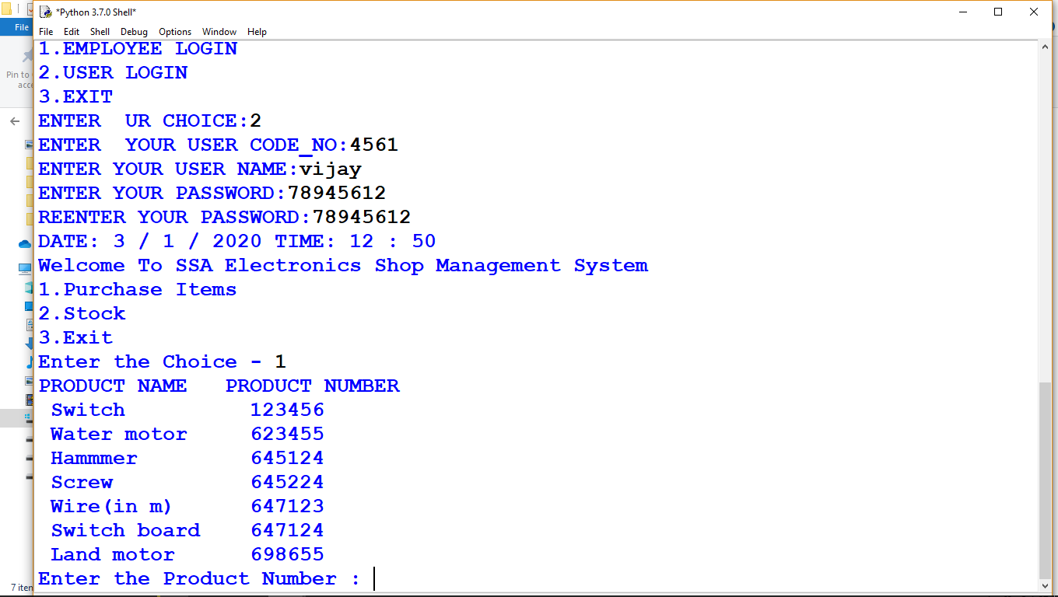
OUTPUT:

Slide 7
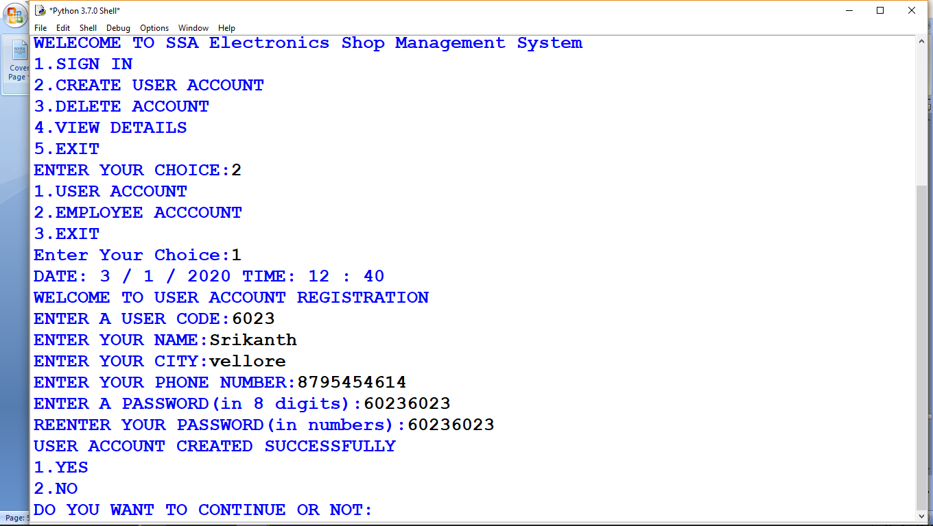

Slide 8
FUTURESCOPE:
In future this software will be there in a high demand as the every thing is getting advanced.
If this software is developed with help of a big database like oracle , the software’s demand will further increase.
As this software is very chea
p, its affordability will be more.

